Slide 1

lululemon athletica
Project Manager: Vanessa Hasbun
Account Director: Matt Thompson
Creative Director: JZ Zaeske
Media Director: Hannah Battreall
Team 2

Slide 2
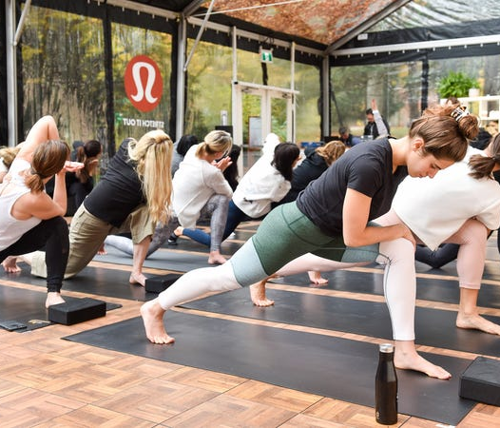
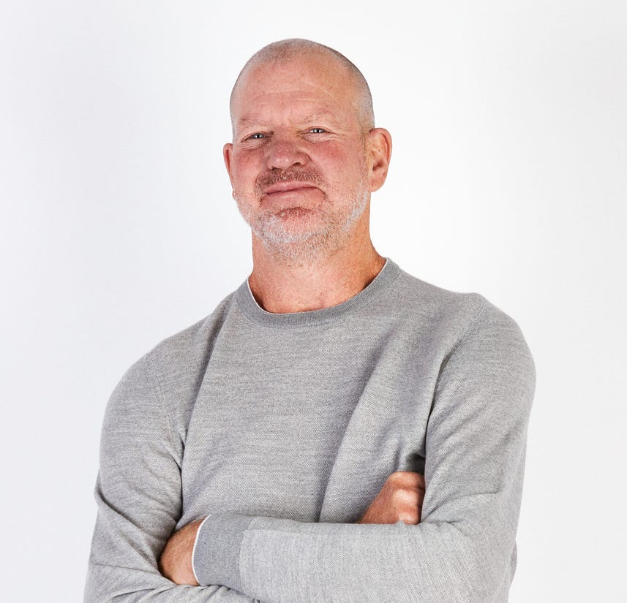
History
Founded by Chip Wilson in Vancouver, Canada in 1998
  Made as a yoga inspired athletic company
Became a standalone store in November 2000
Create clothing for a community invested in healthy living and mindfulness for men and women
Notes:
Lululemon was founded by Chip Wilson in Vancouver Canada in 1998. Originally the company was made for a yoga inspired athletic company.
Became a standalone store in November 2000 after successful sales in its first yoga studio.
Rather than creating clothing customers could sweat in, Lululemon wanted to create a community that could discuss healthy living and mindfulness for both men and women.

Slide 3
SWOT Analysis
Strengths
Premium Brand Affinity
Athleisure Bandwagon
Weaknesses
High Prices
Brand Perception
Strong Balance Sheet
Opportunities
International Expansion
Product Expansion
Threats
Competitive Market
Nike, Under Armour, Gap, etc.
Notes:
Strengths:
Premium Brand Affinity- Lululemon’s products have created more of a cult like following among educated, health conscious and high-income women.
Athleisure bandwagon- More people than ever around the globe have become more fitness conscious. With that being a new trend there is more of a need for clothing that can be worn not only at the gym but out around the town. In today’s day and age it has become more socially acceptable to wear more casual clothing out including dining settings.
Strong balance sheet- Lululemon’s finances are currently in order as the company has no debts and has been doing very well in the stock market compared to a few of its competitors, Under Armor and Nike.
Weaknesses
High Prices- Lululemon’s is notorious for having much higher priced athletic wear as compared to it’s competitors. The company prides itself on top of the line fabrics and research for new fabrics that fit the needs of their customer base. This can be a problem if the company decides to expand its target demographic away from the common target of high income women.
Brand Perception- The company has had a difficult time straying away only selling clothing for Yoga. They have been trying to get other demographics in other physical sports to see that they have clothing for different types of activities.
Opportunities
International Expansion- Lululemon has been working on expanding into Asian and European markets. 93% of their total sales has been coming from their North American Stores. As they do have locations in Europe and Asia already, they are looking to increase revenue in these countries.
Product Expansion- The company has been working on expanding their men’s clothing sector and expanding their target demographic from a female heavy audience to a more universal one. From quick drying clothes for men to bags, they are trying to focus more on running and athletic training for their male segment.
Threats
The market for athletic apparel is extremely competitive as the want for an athleisure lifestyle is trending.
Nike, Under Armor and Gap seem to be Lululemon's biggest threats as they sell athletic clothing catering to larger demographics and have been around much longer.

Slide 4
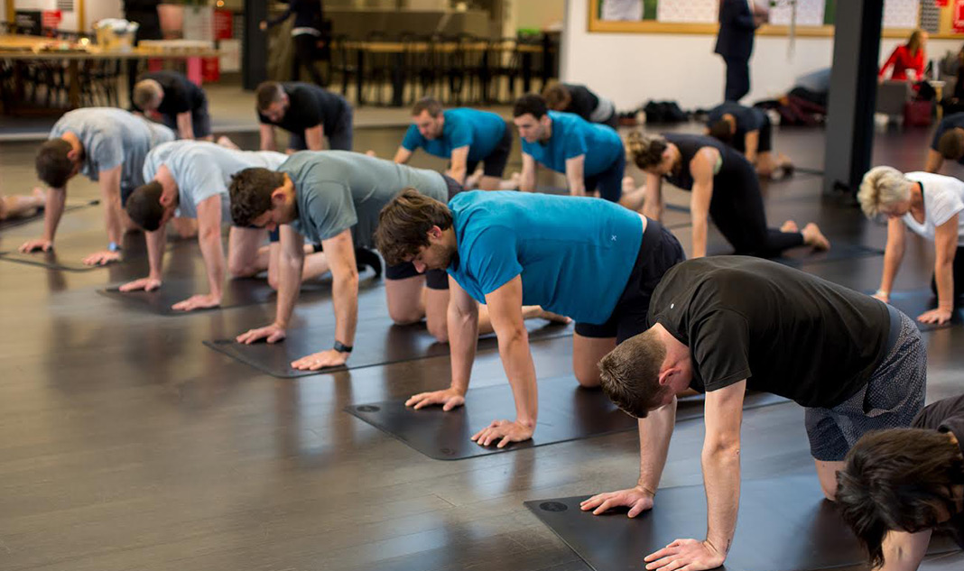
Brand Goal & Objectives
Goal: Become the primary activewear/loungewear brand among millennial men in major cities.
Objectives:
  Creating awareness
  Building preference
  Create engaging activities through social media
Notes:
Goal: To cater to a male demographic dominated by a female target audience.
Objectives
Push comfortable wear for men in a Working from home environment
Flexibility in where to wear clothing
Flexibility in styles

Slide 5

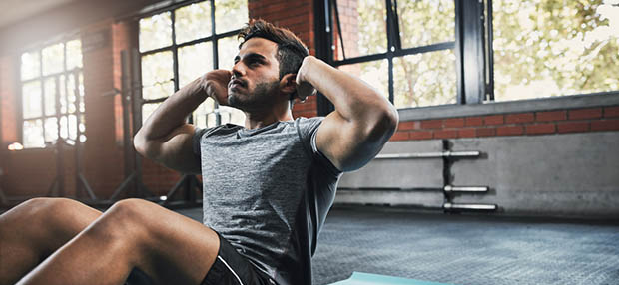
Target Audience
Millennial men (aged 27 – 38)
Men with an active lifestyle
Crave comfort and flexibility with activewear/loungewear
  Ability to go from desk to gym

Slide 6
Lululemon for Men
Comfortable activewear/loungewear to work in during current WFH environment
Promotes a lifestyle that is healthy and encourages mindfulness
Fabrics consist of compression and moisture-wicking designs

Slide 7
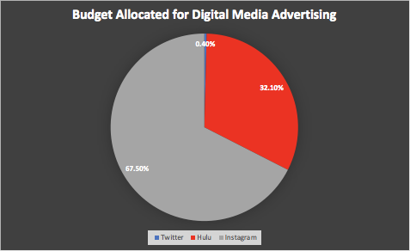
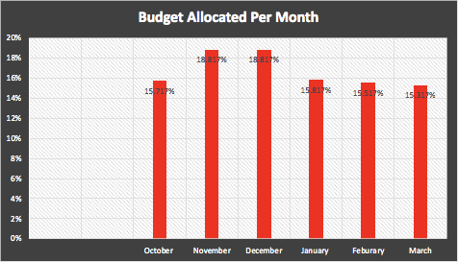
Media Planning

Slide 8
October 2020
Start carousel ad on the 1st of the month
Start commercial ad on the 1st of the month
Release promoted tweet
November 2020
December 2020
Start carousel ad on the 1st of the month
Start commercial ad on the 1st of the month; up the number of showings
Release promoted tweet
Release promoted tweet
Start carousel ad on the 1st of the month
Start commercial ad on the 1st of the month; up the number of showings
January 2021
Start carousel ad on the 1st of the month
Continue commercial ad with slightly less showings
Release promoted tweet
February 2021
March 2021
Start carousel ad on the 1st of the month
Continue commercial ad
Release promoted tweet
Release promoted tweet
Start carousel ad on the 1st of the month
Continue commercial ad but with least number of showings

Slide 9
Total views/clicks per platform
225,000 Clicks
89M Ad-Supported Viewers
2,000 Views

Slide 10
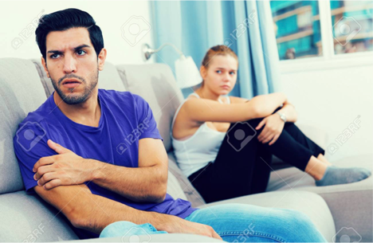

Instagram Ad
Left wondering why I’m stuck with jeans when my girlfriend gets to be comfy in yoga pants….
It’s just not fair she gets the comfy yoga pants…
Targeting men utilizing humor
Jealousy over significant other earing yoga pants and being comfy

Slide 11
Video Advertisement Script – Hulu
Scene opens on a boyfriend and girlfriend cuddled up under a blanket watching movie on the couch. They are eating popcorn. They both reach into the bowl to find it empty.
Girlfriend
I’ve got it babe.
She kisses him on the cheek as she gets up. The blanket tumbles to the floor to reveal her Lululemon yoga pants and his jeans which look very uncomfortable as he keeps adjusting his position trying to get comfortable. She bends over to pick up the bowl of popcorn and stands back up to give us a good view of the Lululemon logo on her pants. She walks around the back of the couch to the kitchen as the boyfriend watches her staring at her pants. He breaks the fourth wall looking directly at the camera
Boyfriend
It’s just not fair. She looks so comfortable in her cute yoga pants while I’m stuck here in these uncomfortable ones. I can’t wear sweatpants on a movie date and look like a total slob. I wish someone made yoga pants for men. Well, not that tight, but you know just as comfy without looking like a slob.
Girlfriend comes back in and sits back down pulling the blanket back up.
Girlfriend
You comfortable hon?
Boyfriend
Of course, babe.
He looks at the camera and mouths no before kissing her on the head. Lululemon logo appears on the screen.

Slide 12
Creative Process
Humor releases serotonin into the brain giving a happy and positive feeling that people seek which is why we chose to go for humor instead of the normal sleek lifestyle ads lululemon usually does
With the clean up over the controversial comments from the Founder Chip Wilson & the behavioral misconduct from former CEO Laurent Potdevin we felt that lululemon needed a new approach to their ads that isn't reminiscent of these scandals
We thought about the features of yoga pants that make them so appealing, and what makes them so appealing across both genders
Guys also in everyday life talk about being jealous of how comfy yoga pants look and our idea was born
A series of ads where the guy is jealous of the yoga pants his significant other is wearing

Slide 13
References
Retrieved from https://advertising.hulu.com
Build your business on instagram. Retrieved from https://business.instagram.com/advertising/
How much does it cost to advertise on instagram? Retrieved from https://influencermarketinghub.com/how-much-does-it-cost-to-advertise-on-instagram/
How much does it cost to advertise on twitter? Retrieved from https://www.webfx.com/social-media/how-much-does-it-cost-to-advertise-on-twitter.html
Lululemon Scandals retrieved from: https://www.nytimes.com/2018/02/05/business/lululemon-ceo-resigns.html

