Slide 1
Archdiocese of Chicago:
General Consumer Survey
PRAD 585 Research, Data and Insights
Jonathan Lomax, Madi Shaw, JZ Zaeske, Matt Thompson, Mike Garcia
DePaul University
March 2021

Slide 2
Introduction
Young Adult Engagement Team” is located in Chicago Illinois.
Their main focus is to serve as an outreach for young adults to reinstate their confidence in the Catholic Church.
They strive to spark a light in the youth that has been dimmed by their disengagement in the past years.
With a focus on social media and other outlets they hope to raise awareness and provide stability to the youth who have been led astray.
“The team’s goal is to create attractive Christian communities that invite disengaged young adults in Chicago to experience Jesus Christ and His unconditional love for them” (AOC).
The AOC has reached out to us to further look into their media outlets and provide insight to help spread the word.
The AOC’s strive to better the community aligns with our ideals at DePaul.
We are honored to help in any way possible.

Slide 3
Methods
44 Question survey
  Subcategories:
    Demographics
    Religiosity
    Political Affiliation
    Effects of COVID
    Mental Health
    Feelings Toward Catholicism
  Question types:
    Agreeance rating (following a statement)
    Rankings (by significance given a list of options)
    Open-Ended
563 analyzed responses

Slide 4
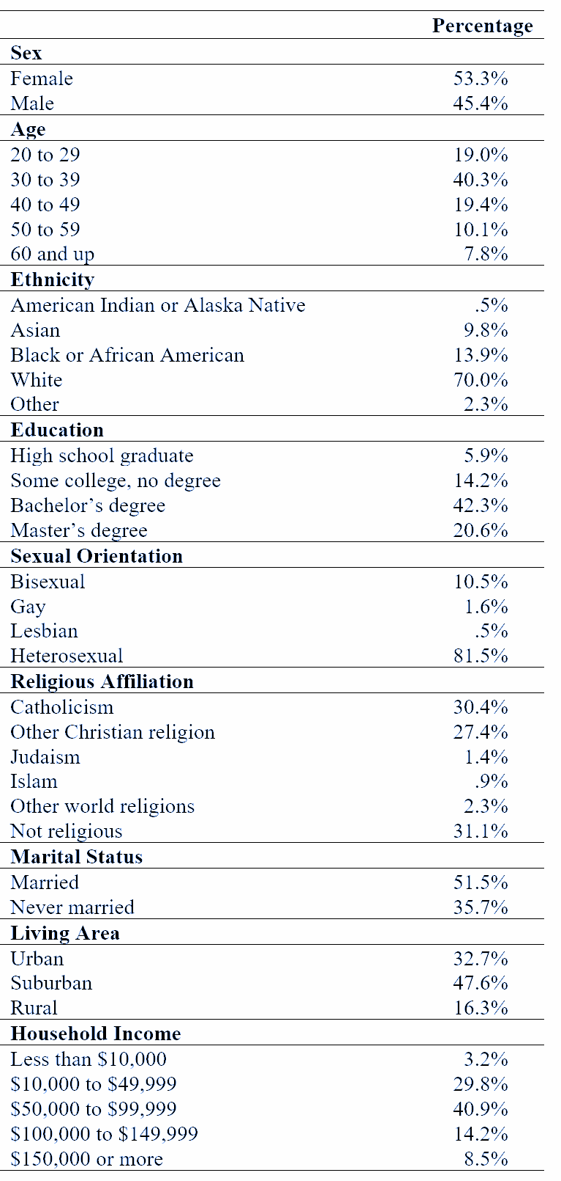
Study Participants
N = 563
From Amazon MTurk
Slight female majority, most with a bachelor’s degree making between $50-99k a year, living in suburbs, mostly white, mostly heterosexual, with an average age of 39

Slide 5
Findings and Suggestions

Slide 6
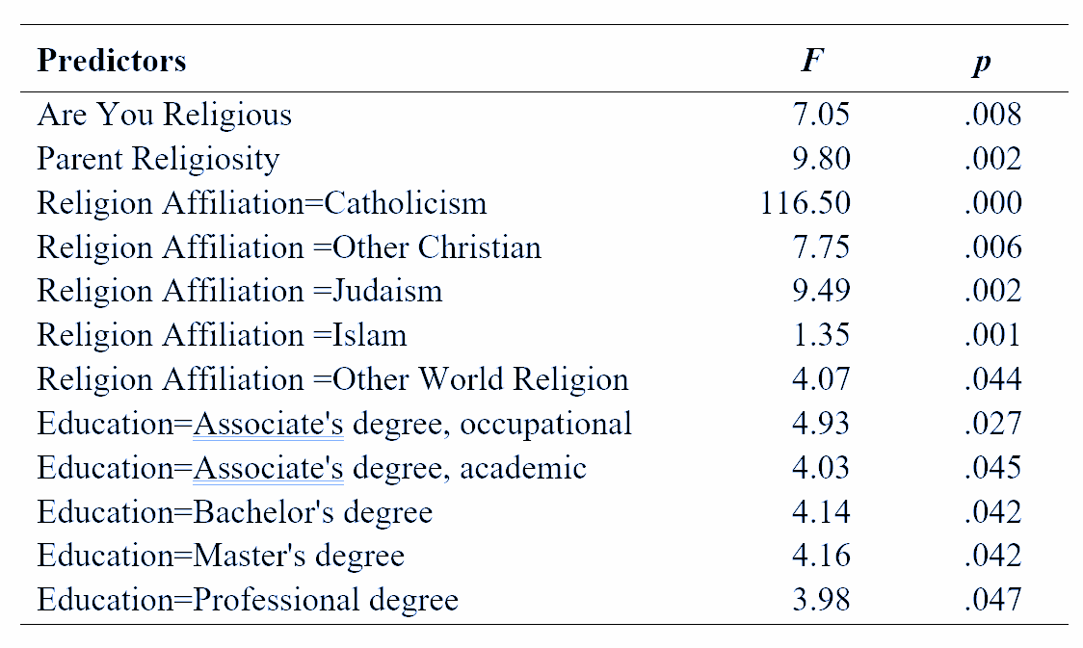
General attitude towards the Catholic Church
How do you feel when you think about the Catholic Church or think about joining the Catholic Church?
(Bad-Good, Negative-Positive, Unpleasant-Pleasant, Unfavorable-Favorable, 7-point scale)
Mean = 4.04 (7-point scale), indicating above average favorable attitudes
The below factors positively affect general attitudes towards the church:
  Religiosity
  Parents’ religiosity
  Education level
However, age, sex, sexual orientation, ethnicity, income level, living area, and political orientation showed no effects to attitudes towards the church

Slide 7
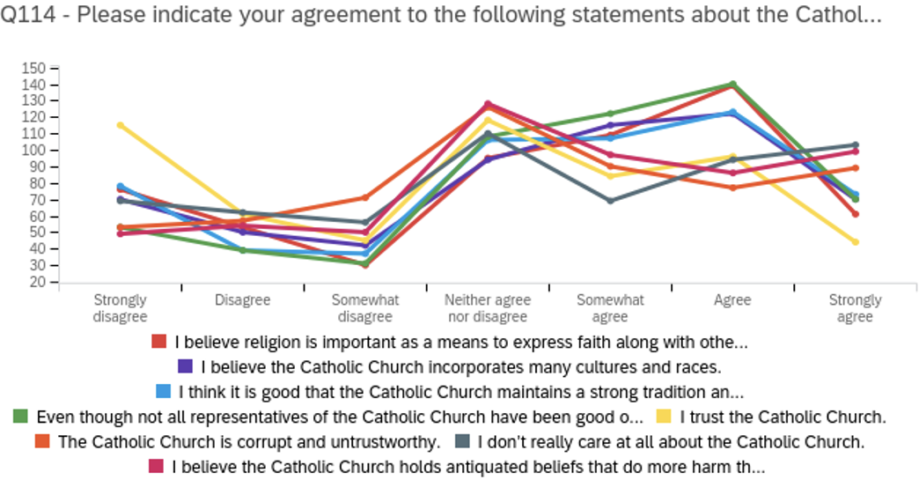
Specific attitudes and trust in the Catholic Church

Slide 8
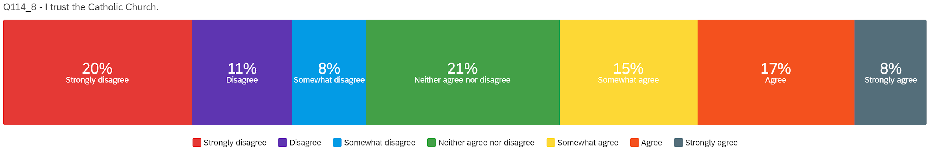
Trust the Catholic Church?
Mean = 3.82 (7-point scale), indicating disagreement or lower than average trust in the Catholic Church
20.4% participants (n = 115) stated they strongly disagree that they trust the church
7.8% stated that they trust the church

Slide 9
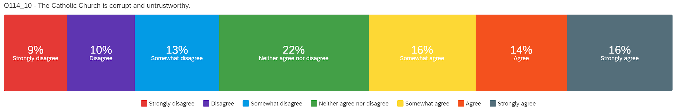
The church is corrupt and untrustworthy?
Mean = 4.30 (7-point scale), indicating average agreement on this statement
15.8% (n = 90) strongly agree in this statement
9.4% strongly disagree
22.4% (n = 126) neither agree nor disagree

Slide 10
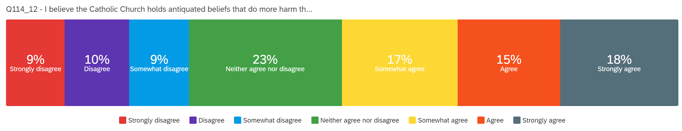
Church’s antiquated beliefs doing more harm than good?
Mean = 4.47 (7-point scale), indicating agreement or the church’s antiquated beliefs are doing more harm than good
17.9% (n = 101) strongly agreed with the statement
8.7% strongly disagreed
22.7% chose neither agree nor disagree

Slide 11
Summary about attitude and trust
We need to create an incentive program for the community so that people will attend more and overall trust in the Church will rise.
Meet and greets when Covid is over is essential. We need to formulate a way for the AOC to get out their and create a safe path towards informing.
Our survey questions highlighted major factors that have hindered the Catholic church by pointing these out we can hone in on reworking the communities views and values.
Trust needs to be regained. Low trust levels can equate to lower participation
We need to implement a plan of action to show the community that the Catholic church would never lead them astray.
We used these questions to gauge the attitudes towards the church so that we can accurately help the AOC pinpoint major issues
By fixing the issues we can then help gain more followers.
As shown in the result above our focus needs to be on gaining back the communities trust.
Common element arising is the lack of belief in the church.
It is prevalent throughout the survey we presented.

Slide 12
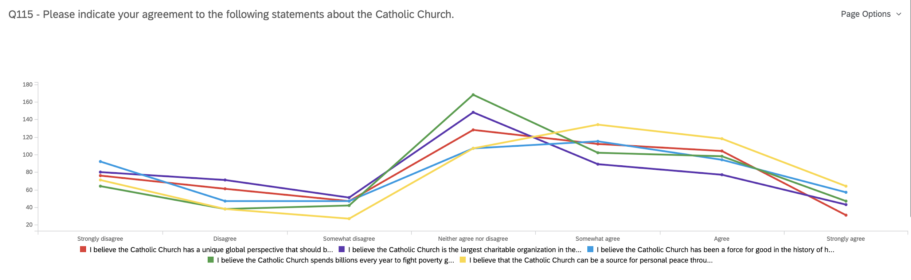
Beliefs Surrounding the Catholic Church

Slide 13
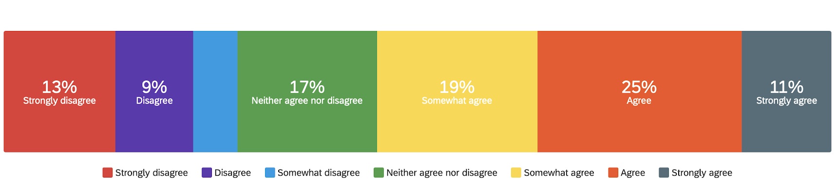
The Church has a unique global perspective that should be taken into account
Mean = 3 (7-point scale), indicating a general disagreement with the notion of the church having a unique global perspective
5.55% strongly agreed with the statement
13.6% strongly disagreed
22.9% chose neither agree nor disagree

Slide 14
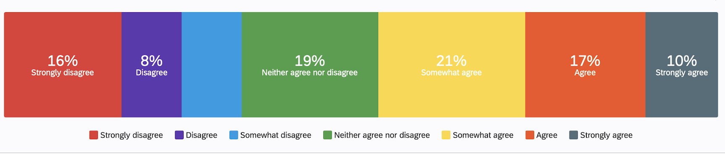
The Church has been a force of good throughout the history of humanity
Mean = 3.1 (7-point scale), indicating the majority do not believe the Catholic Church has been a force of good.
10.2% strongly agreed with the statement
16.46% strongly disagreed
19.14% chose neither agree nor disagree

Slide 15
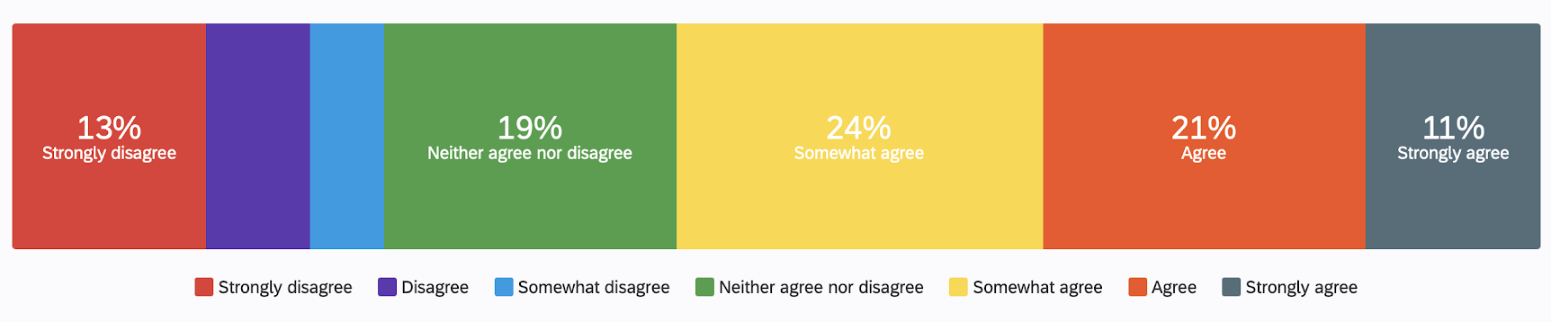
The Catholic Church can be a source of peace through it’s meditation and prayer practices
Mean = 3.4 (7-point scale), indicating general disagreement with the statement above.
11.45% strongly agreed with the statement
12.7% strongly disagreed
19.14% chose neither agree nor disagree

Slide 16
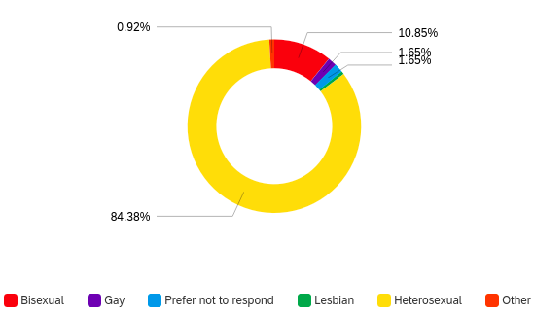
LGBTQ+ Community & Catholicism
The majority of participants were of Heteroseuxal identification
Bisexual was the second largest identifier amongst the participants
In order to verify the following insights another survey for the LGBTQ+ community to generate a larger subset of data would be recommended
The overall mean was 4.0 out of 7

Slide 17
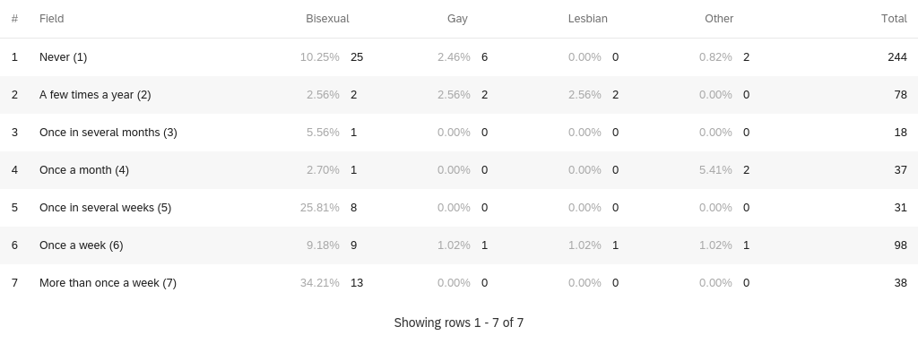
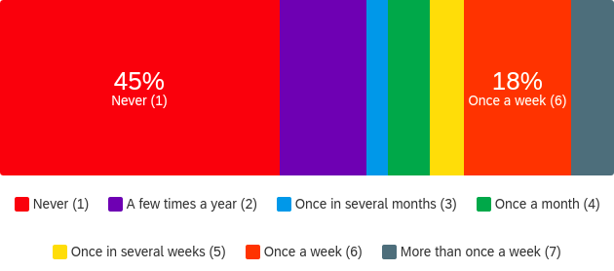
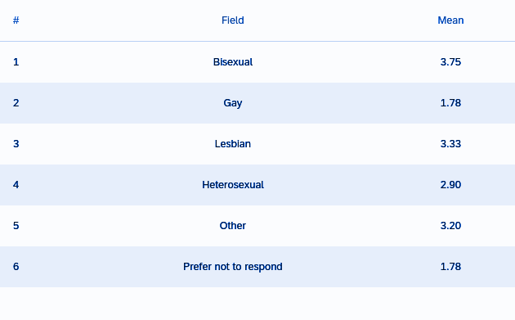
Church Attendance
The results indicate that the LGBTQ+ community will attend church about the same amount as the heterosexual community
(Mean is on a 7 point scale)

Slide 18
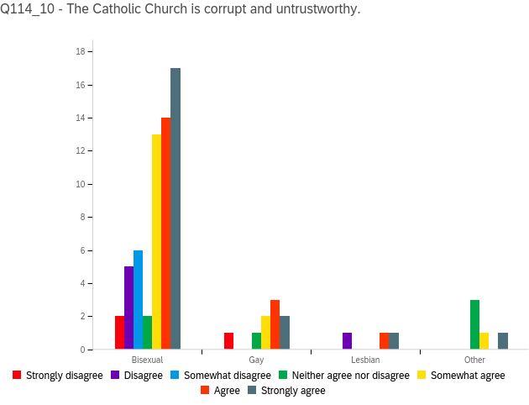
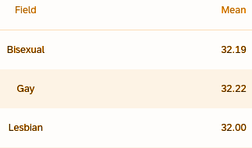
While previous data indicates that the LGBTQ+ community is attending church, there is clearly some strong resentment towards Catholicism as a whole among the community.
(The mean is out of a 27-34 point scale)

Slide 19
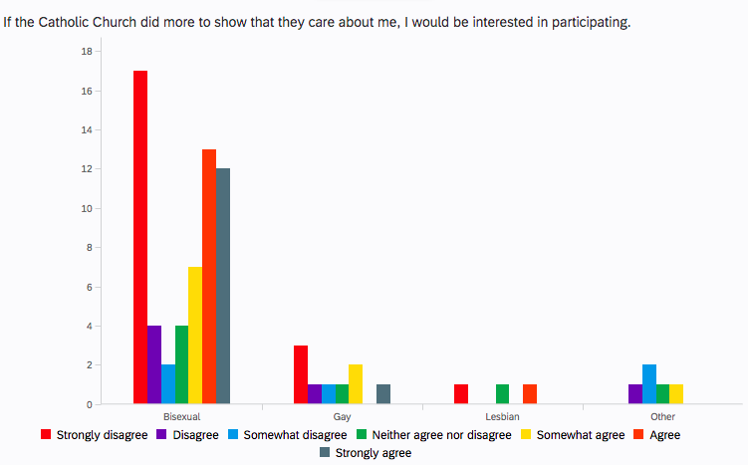
Openness to Catholicism Among the LGBTQ+ Community
There is an openness to rejoin the Catholic Community when it involves events that do positive things for the community
The LGBTQ+ Community is clearly hurt by the lack of belonging felt due to certain teachings
(The mean is out of a max of 32 scale)
MEAN
Bisexual - 30.41
Gay - 29.22
Lesbian - 29.67

Slide 20

Impact on Mental Health
I will take drugs to treat my anxiety.
Mean = 3.0 (0-7 Point Scale), Indicating that most people did not take drugs to cope with their anxiety during the global pandemic.
38% or 208 participants in the survey admitted that they strongly disagree with taking drugs.
Only 6% strongly agreed. We also found that most who used drugs to cope with anxiety came from an Islamic background.
More participants in the survey were older females who had more trouble coping with anxiety than males.

Slide 21

Impact on Mental Health
I consider prayer to God as a resource for anxiety
Mean= 4 (0-7 Point Scale) indicating that it was a pretty even percentage across the board.
Although 26% said they strongly disagree, there is still a high percentage of those who do use God as a resource for anxiety.
In times of crisis, (A Global Pandemic) many people still seek religion as a way of coping with their anxiety.
Notes:
Fix the indication does not apply

Slide 22
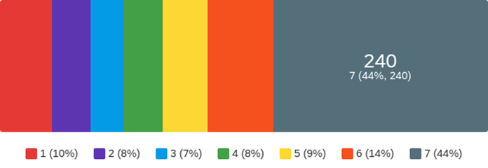
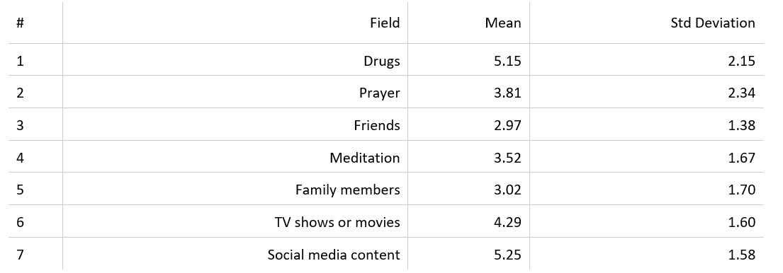
Impact on Mental Health when feeling overwhelmed
Q108 - When I am feeling overwhelmed by my mental health issues, I would turn to... (please rank the order of the following by likelihood)
Mean= 5 (0-7 Point Scale) for use of drugs and social media content when feeling overwhelmed.
(N) value for Drugs= 57 participants say they resort to drugs to cope with their mental health when feeling overwhelmed.
(N) value for Social Media Content= 240 participants went to their social media to help their mental health when feeling overwhelmed.
Lowest Mean= 3 (0-7 Point Scale) resorted to Friends and the same mean was found for Family members when feeling overwhelmed
(N) value for Friends= 37 Participants
(N) value for Family= 50 Participants

Slide 23
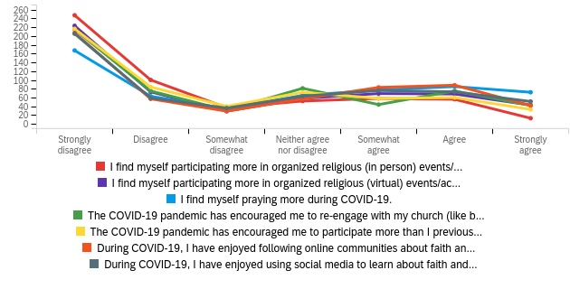
Religious Involvement During COVID-19

Slide 24
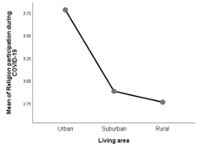
Religious Involvement During COVID-19
Living area is a key predictor in religious involvement during COVID-19
Urban mean = 3.75 <, compared to Suburban and Rural means = 3.0 >
  This tells us that those living in urban communities are more likely to practice religion during the pandemic

Slide 25
Religious Involvement Post COVID-19
Table 6. ANCOVA results about religion participation intention after COVID-19 across groups of participants (only showing significant predictors)
Note. R² = .65, adjusted R² = .57.
Predictors | F | p | η²_{p}
Are You Religious | 23.71 | .000 | .052
Are You Spiritual | 9.97 | .002 | .023
Religion Affiliation=Catholicism | 26.36 | .000 | .058
Religion Affiliation=Other Christian | 35.88 | .000 | .077
Religion Affiliation=Judaism | 15.60 | .000 | .035
Religion Affiliation=Islam | 6.51 | .011 | .015
Religion Affiliation=Other World Religion | 4.86 | .028 | .011
Ethnicity=Asian | 4.74 | .030 | .011
Living Area=Urban | 5.06 | .025 | .012
Key takeaways:
  Those who consider themselves religious and/or spiritual, those who identify as asian, and those living in urban communities are more likely to participate post COVID-19
  It is our strong suggestion the AoC hold community spiritual events to engage with Chicago’s urban communities

Slide 26
Business Strategy:
Lack of trust - gain trust
Community outreach and partnerships with strategic organizations
  Homeless shelters
  LQBTQ+ organizations
  Women’s Centers
  Food banks
Create and execute an authentic mission that resonates with young adults
Re-engage young adults by partnering with organizations that are important to them
Importance of authenticity

Slide 27
Limitations in study
In our study we had to rely on the workers at Amazon to make sure our study was conducted the way we wanted it to be.
Participants were self picked, where they were able to choose whether they wanted to participate in our study so it was not a true random set of test subjects.
563 participants on a national level. We can always benefit from a larger number of respondents
Survey was conducted during abnormal times of a global pandemic where situations are completely different if this study were conducted a year ago.
Our survey tested mainly for quantitative data. We may have the answers to our questions but due to a large sample size it was not sufficient enough to get the “Why” questions answered.

Slide 28
Conclusion
Ultimately, our survey seeked to uncover which, if any, political/spiritual stances millennials seem to disagree with the Catholic church on, as well as which perceptions (faith being “uncool”, stagnation, lack of community reach, etc.) are driving a wedge between the church and millennials.
Also, we learned what sort of attractions (spiritual growth, sense of community, service of others, etc.) would be most effective at enticing millennials to engage with the church.
Through our findings we concluded that the Catholic church has some trust issues to absolve.
In order to fix these issues the AOC will need to create more outlets so that they can spread the word of the lord and also be able to show the people that the Catholic church can be trusted.

