Slide 1
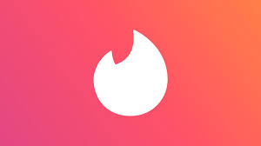
Tinder
Project manager: Matt Thompson
Account director: Hannah Battreall
Media director:
JZ Zaeske
Creative director: Vanessa Hasbun

Slide 2
History
Tinder is an online dating app that allows users to swipe to like or dislike someone’s profile based on pictures and bio
Launched on September 12th, 2012 on iOS and then on Android
Founded by Sean Rad, Jonathan Badeen, Justin Mateen, Joe Munoz, Dinesh Moorjani, and Whitney Wolfe
In 2017, Tinder created a web version of the app to allow people to use the service online
As of 2020, Tinder has been downloaded by users more the 340 million times

Slide 3
SWOT Analysis
Strengths | Weaknesses | Opportunities | Threats
Brand awareness High demand for dating app User-friendly (easy to use) Cheap | Users may block collection of personal information, making it harder to match people with them Privacy concerns Associated as “hook-up” app Vulnerability of information on users | Big market for dating apps, so a lot of room for adaptation of app New technology allows for new features to the app Expansion to new regions of the world who don’t use the app already | Increasing number of other dating apps, such as, Bumble, Hinge May be a ban on tracking user information

Slide 4
Brand Goals and Objectives
Increase app usage by 5% to 10% as a result of a 6-month ad campaign
Change perception of Tinder being a hookup only app to a relationship focused app
Increase awareness of Tinder's new phased perception between competitors like Hinge, Bumble, Coffee Meets Bagel and The League

Slide 5
Target Audience
The target audience we would like to cater to would be for those living in the suburbs where there are more limited means on meeting local singles
Target age group: 18-32
Targeting all genders and sexual orientations
Target income level: students to young professionals
  App is free, so income won't be a deterring factor

Slide 6
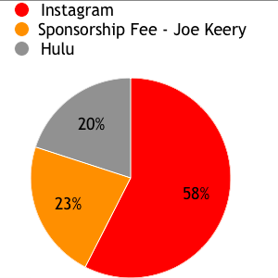
Media Planning-Budget
Instagram
  $575,000
Sponsorship Fee – Joe Keery
  $225,000
Hulu
  $200,000
Total Budget
  $1,000,000

Slide 7
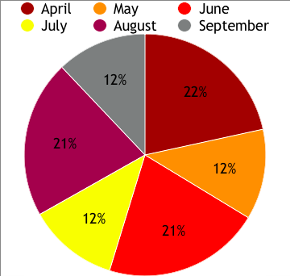
Monthly Budget Overview

Slide 8
Timeline
Hulu
April | $45,000 | 4.5%
May | $25,000 | 2.5%
June | $40,000 | 4.0%
July | $25,000 | 2.5%
August | $40,000 | 4.0%
September | $25,000 | 2.5%
Sponsorship Fee
April | $75,000 | 7.5%
May | $0 | 0%
June | $75,000 | 7.5%
July | $0 | 0%
August | $75,000 | 7.5%
September | $0 | 0%
Instagram
April | $95,833 | 9.58%
May | $95,833 | 9.58%
June | $95,833 | 9.58%
July | $95,833 | 9.58%
August | $95,833 | 9.58%
September | $95,833 | 9.58%

Slide 9
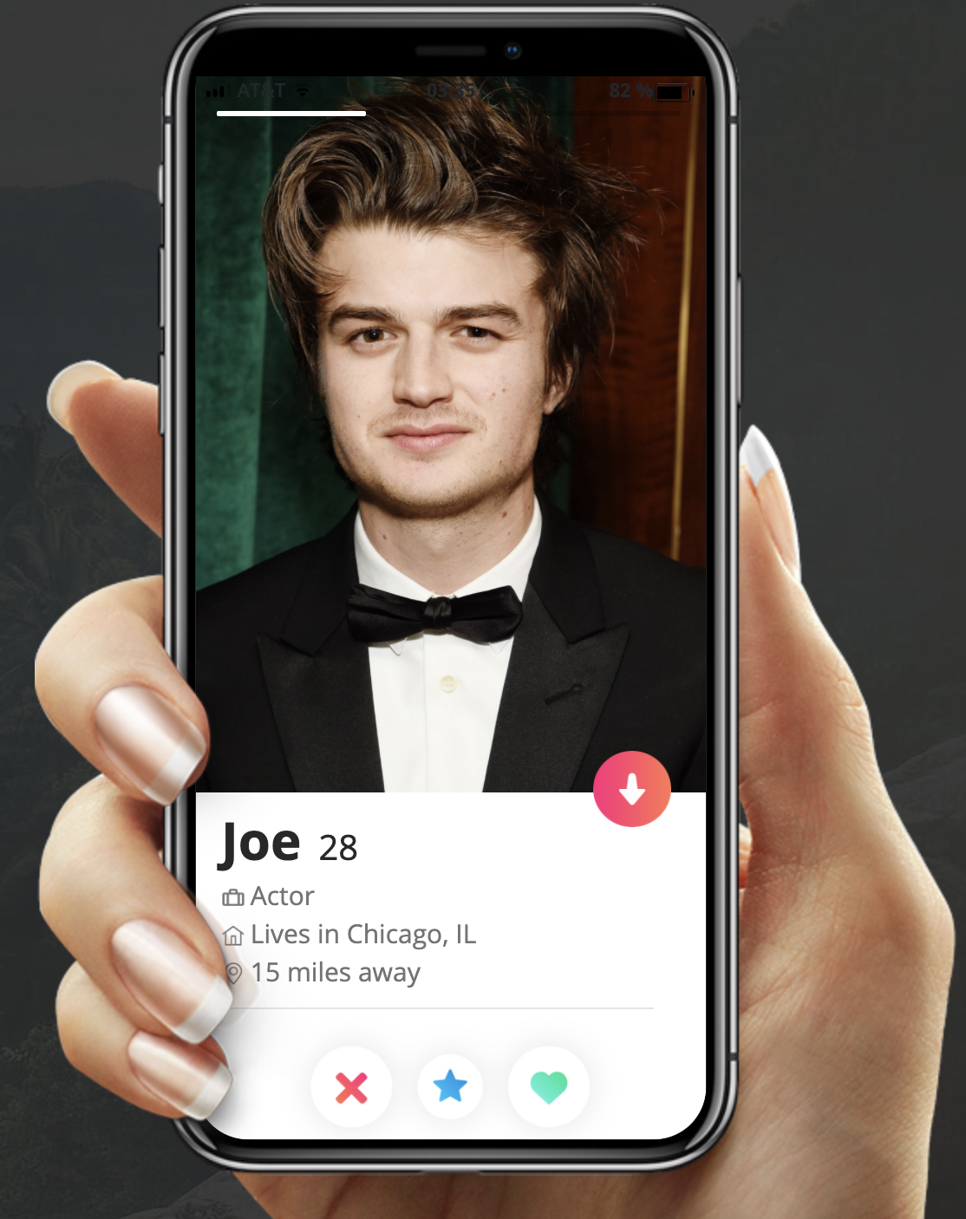

Creative 1 – Instagram Ad
“Things are about to get stranger for Joe and his love triangle... Joe downloaded Tinder. Lookin’ for love in the strangest of places 😉🔥❤️”

Slide 10
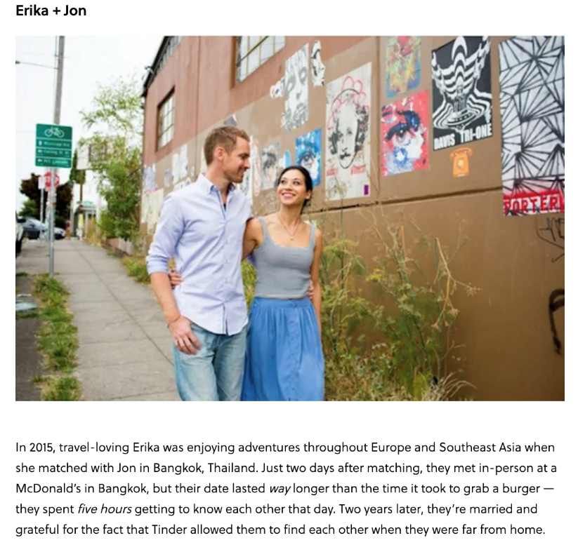
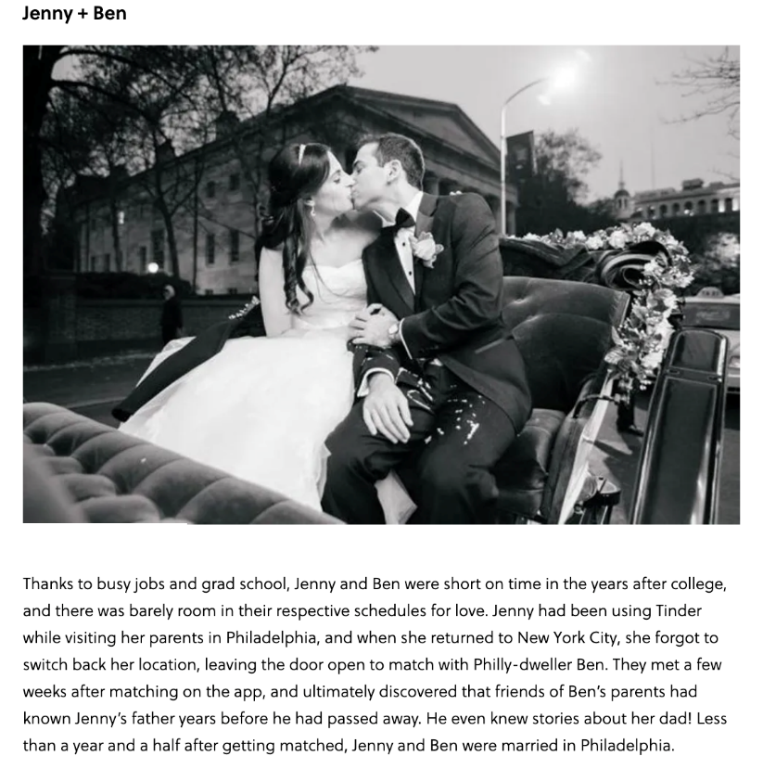
Creative 2 – Hulu Ad
Success Stories
  Romantic Relationships
  Friendships
Tinder is the place to meet people
← Example stories from BRIT+CO

Slide 11
Creative Process
In accordance with our objectives, in order to increase app usage to 5%-10%, and given our target audience—students and young professionals aged 18 to 32—we aimed for our creatives to be on Instagram and Hulu
  75% of Instagram users are 18-24 (Sprout Social, 2020)
  57% on Instagram users are 25-30 (Sprout Social, 2020)
  Average age for a Hulu viewer is 31 (Much Needed, 2020)
  32 million people view Hulu with ads (Much Needed, 2020)
We decided to include Joe Keery, of Stranger Things, to promote Tinder as he’s a very popular actor in our given target audience
Offering 43 billion matches to date, Tinder—the world’s most popular dating app—is the perfect place for dating, making friends, and meeting new people (Tinder)

Slide 12
References
Chen, J. (2020). Social media demographics to inform your brand's strategy in 2020. Retrieved from https://sproutsocial.com/insights/new-social-media-demographics/
Kosik, A. H. (2017). 5 tinder success stories that will restore your faith in love. Retrieved from https://www.brit.co/5-tinder-success-stories-that-will-restore-your-faith-in-love/
Much Needed. (2020). Hulu by the numbers: User statistics, demographics, and fun facts. Retrieved from https://muchneeded.com/hulu-statistics/#:~:text=The%20average%20age%20of%20a%20Hulu%20subscriber%20is%2031&text=For%20a%20perspective%2C%20this%20is,millennials%20subscribe%20to%20OTT%20services
SWOT analysis of tinder. Retrieved from https://freeessays.club/swot-analysis-of-tinder/
Tinder. Retrieved from https://tinder.com/?lang=en
Tinder information, statistics, facts and history. Retrieved from https://www.datingsitesreviews.com/staticpages/index.php?page=Tinder-Statistics-Facts-History#:~:text=Tinder%20History%20Summary,later%20left%20and%20started%20Bumble).&text=In%202017%20Tinder%20released%20a%20web%20version%20of%20their%20service.

