Slide 1


By: Matt Thompson

Slide 2
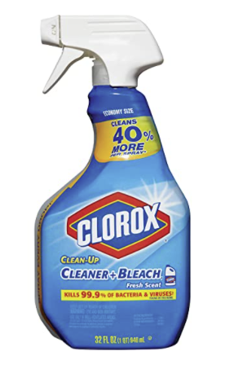
What Clorox is
Clorox is a family brand.
It brings the cleaning and disinfecting power of bleach to the world.
Ensures products are safe and effective for their consumers

Slide 3

What does Clorox need from us
Clorox wants us to find a way to increase demand
Clorox wants us to find a way to increase brand loyalty
Clorox wants us to show that the company stands for more than just the product

Slide 4

What we found
Clorox took a big hit in the market in Q4
Clorox spent time building up their capacity so to meet the demands of their consumers that was an issue during the pandemic
With their being an increase in competition when their products were not making it consistently on the shelves you took a step back to increase production

Slide 5
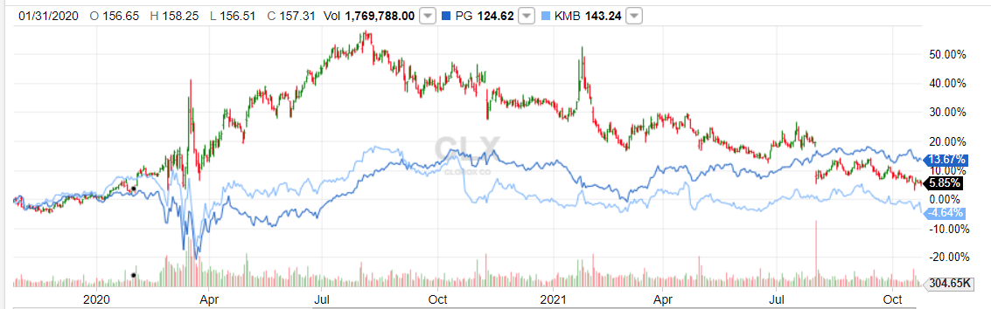
Clorox, P&G and Kimberly Clark 2 Year Stock Performance
-Red and Green line is Clorox
-Light Blue line is KMB
-Dark Blue line is P&G

Slide 6
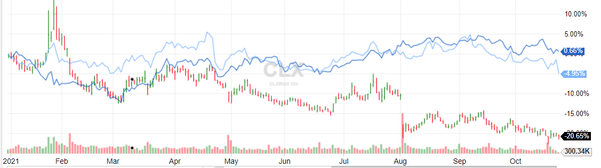
Clorox, P&G and Kimberly Clark YTD Stock Performance
-Notice the drop off in August with their stock performance.
-Notice KMB and P&G still steady.

Slide 7

Strategy
With Clorox products sold out on shelves all over America during the pandemic, consumers needed to purchase whatever they could do stay safe
We need to show consumers that we will always be here when they need us.
To show them we won’t be running out of product
Show them we won’t give them a reason to purchase any other cleaning products other than our own. The brand they trust

Slide 8
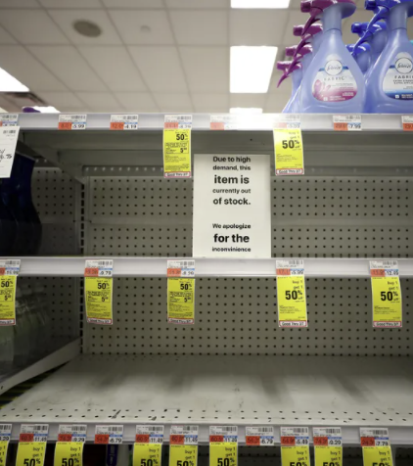
Creative
You will never see this again.

Slide 9


Slide 10
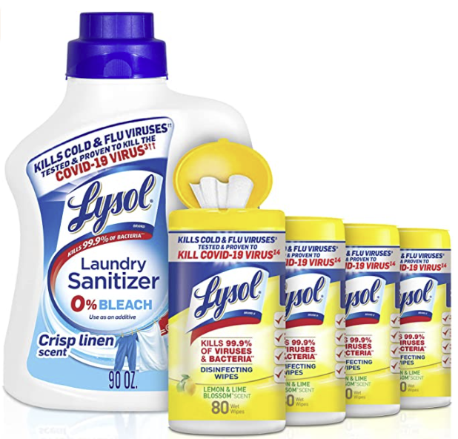
Clorox Promise
Since Clorox wasn’t always there when consumers needed them most, you all stepped up to ensure that won’t happen again. Even if it cost you more money to do so.
Consumers will never have to see the backs of shelves again. Clorox will always be available.
Let’s get our loyal consumers back to the brand they trust the most.

Slide 11
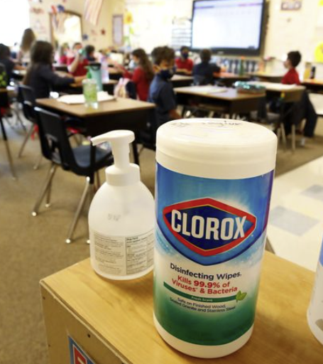
Conclusion
We have seen a shift in brand loyalty.
We are still fighting this pandemic.
Competition is doing just as well in the market as you are
Why should consumers choose us?
We’re here for you

